Slide 1
Design of MASSIVE
Design Criteria
Grammar
Semantics

Slide 2
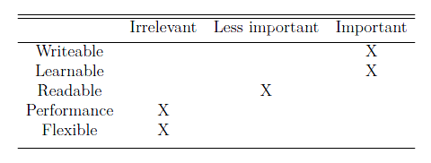
Design Criteria for MASSIVE
Should be easy to use
  Similarities to popular languages
  Simple

Slide 3


Grammar of MASSIVE
Blocks
  { Commands }
Simple datatypes
  Bool, string and num
Statements
  if, for, while

Slide 4
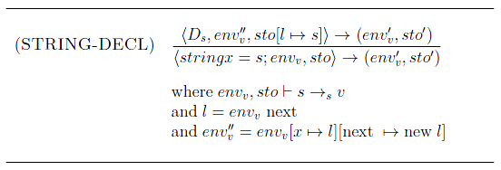
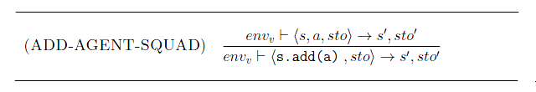
Semantics of MASSIVE

